Slide 1
CIS8695 Managing Big Data Analytics
Nasim Mousavi
Assistant Professor
J. Mack Robinson College of Business
Georgia State University
nmousavi@gsu.edu

Slide 2
Main Ideas
Linear regression is a popular forecasting model to capture linear trend and seasonality
Modify & use also for non-linear trends
Exponential
Polynomial

Slide 3
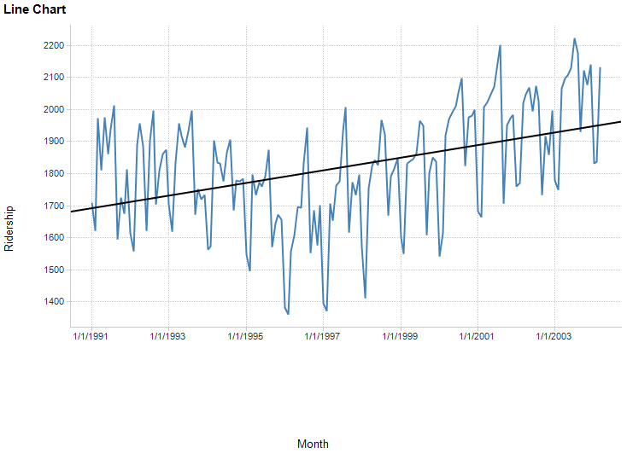
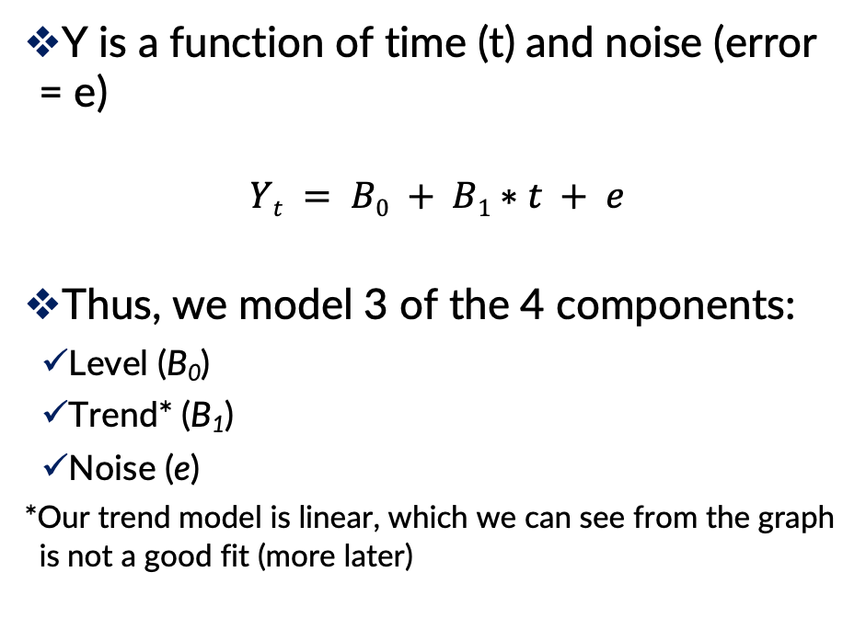
Regression Model
Y is a function of time (t) and noise (error = e)
$$Yt = B0 + B1∗t + e$$
Thus, we model 3 of the 4 components:
Level (B₀)
Trend* (B₁)
Noise (e)
*Our trend model is linear, which we can see from the graph is not a good fit (more later)

Slide 4
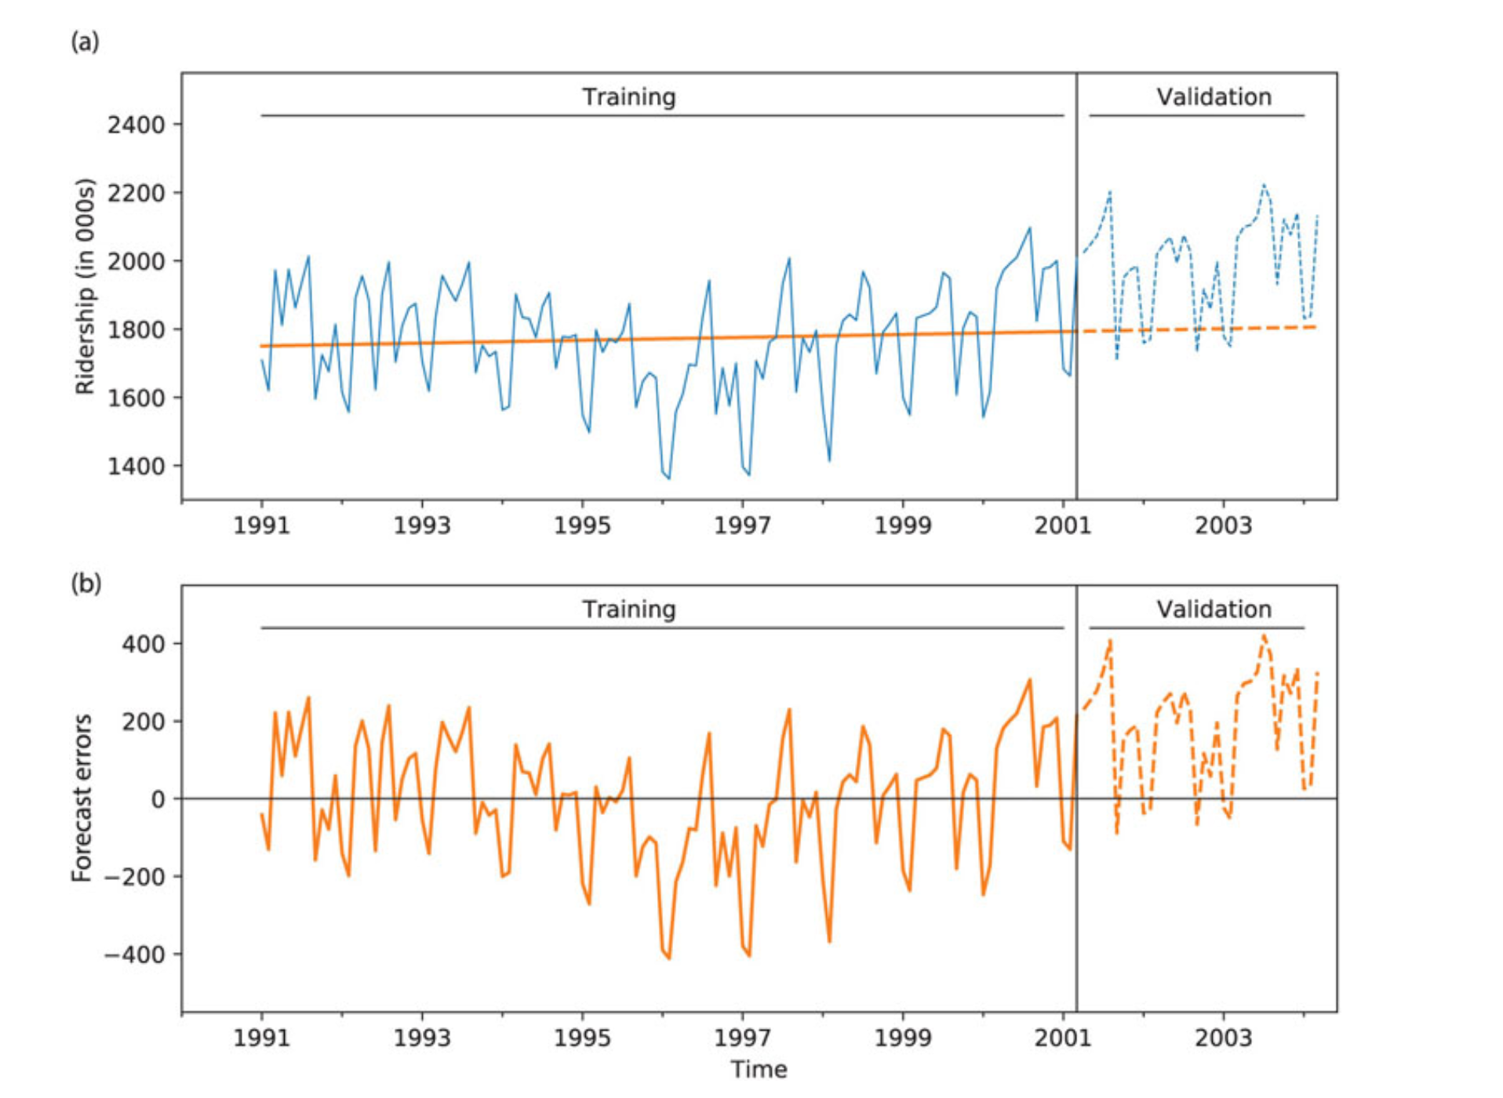
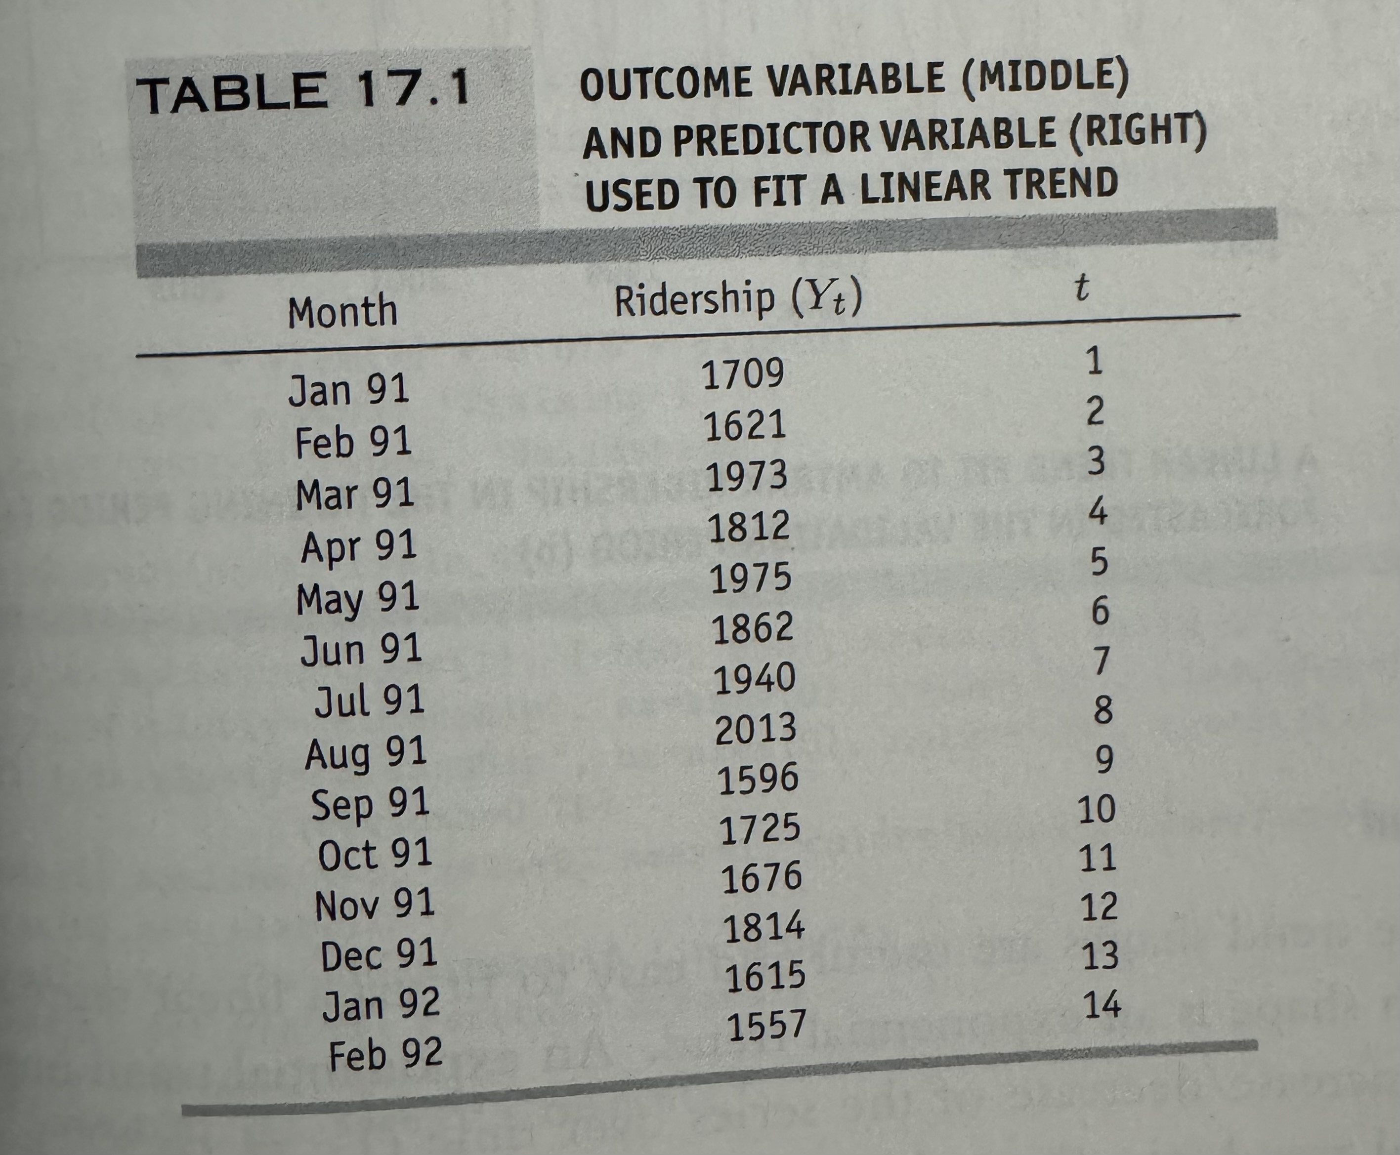
Regression Model

Slide 5

Exponential Trend
Several alternative trend shapes are useful and easy to fit via a linear regression model
Appropriate model when increase/decrease in series over time is multiplicative
e.g., t₁ is x% more than t₀, t₂ is x% more than t₁…
To fit an exponential trend, simply replace the outcome variable Y with log Y (where log is the natural logarithm), and fit a linear regression
log(Y_{i}) = B₀ + B₁t + e

Slide 6
Exponential Trend
Note that performance measures in standard linear regression are not in original units
Model forecasts will be in the form log(Y)
Return to original units by taking exponent of model forecasts
Calculate standard deviation of these forecast errors to get RMSE

Slide 7
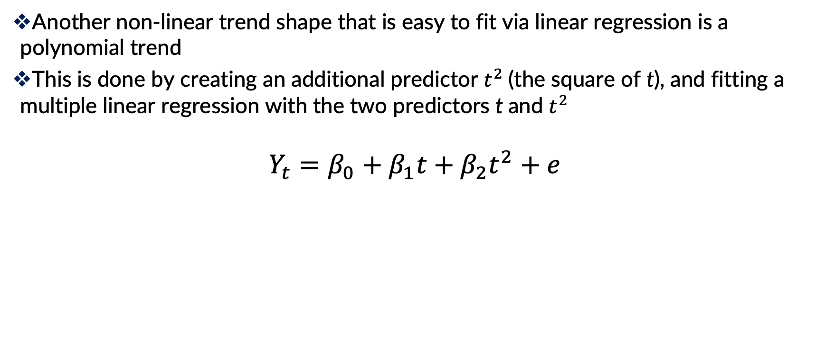
Polynomial Trend
Another non-linear trend shape that is easy to fit via linear regression is a polynomial trend
This is done by creating an additional predictor $t^{2}$(the square of t), and fitting a multiple linear regression with the two predictors t and $t^{2}$
$$Y_{t}=β_{0}+β_{1}t+β_{2}t^{2}+e$$

Slide 8
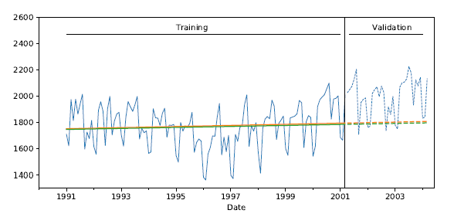
Exponential Trend
Exponential trend (green) very similar to linear trend (orange) - neither copes well with initial period of decline followed by growth period

Slide 9
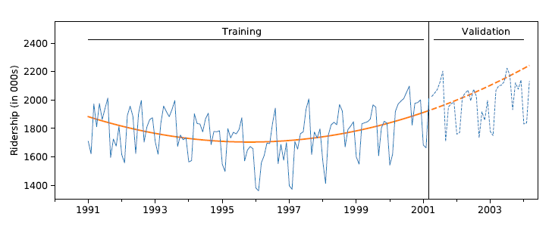
Polynomial Trend
Fit linear regression using both t and t²
Better job capturing the trend, though it over forecasts in validation period.
Next: we’ll try capturing seasonality.

Slide 10
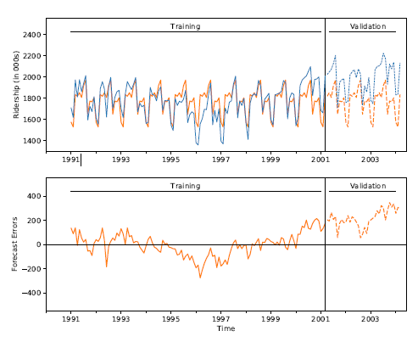
Handling Seasonality
A seasonal pattern in a time series means that periods that fall in some seasons have consistently higher or lower values than those that fall in other seasons
Examples are day-of-week patterns, monthly patterns, and quarterly patterns
Handle in regression by adding a new categorical variable for each season

Slide 11
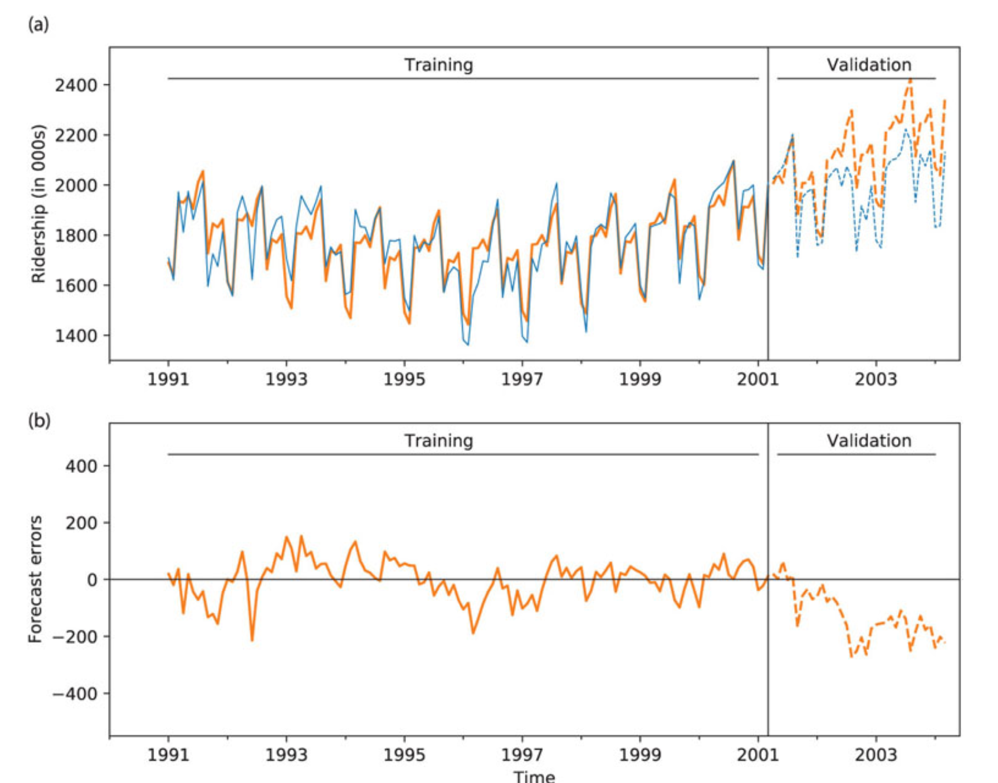
Model with Trend and Seasonality
Incorporates quadratic trend and seasonality
13 predictors:
11 monthly dummies
t
t²

Slide 12
Simple Smoothing Methods
A second class of time series models
Regression methods assume underlying unchanging structure (linear, exponential, polynomial)
Smoothing derives forecasts based directly on the data alone (e.g. averaging), with no mathematical structural assumptions
These methods “smooth” out the noise in a series to uncover the patterns
Smoothing is done by averaging the series over multiple periods

Slide 13
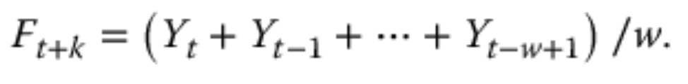
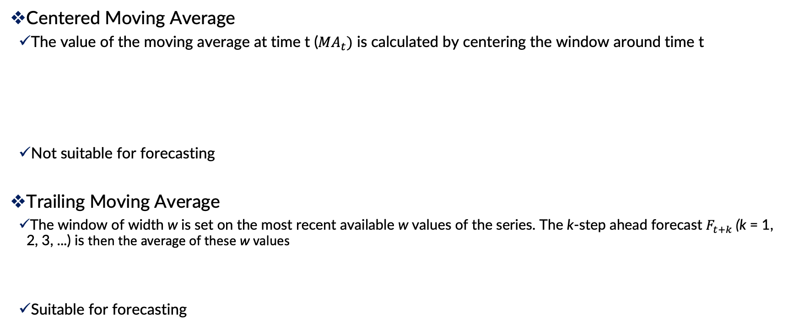
Simple Smoothing Methods: Moving Average
Centered Moving Average
The value of the moving average at time t (${MA}_{t})$ is calculated by centering the window around time t
Not suitable for forecasting
Trailing Moving Average
The window of width w is set on the most recent available w values of the series. The k-step ahead forecast $F_{t+k}$(k = 1, 2, 3, ...) is then the average of these w values
Suitable for forecasting

Slide 14
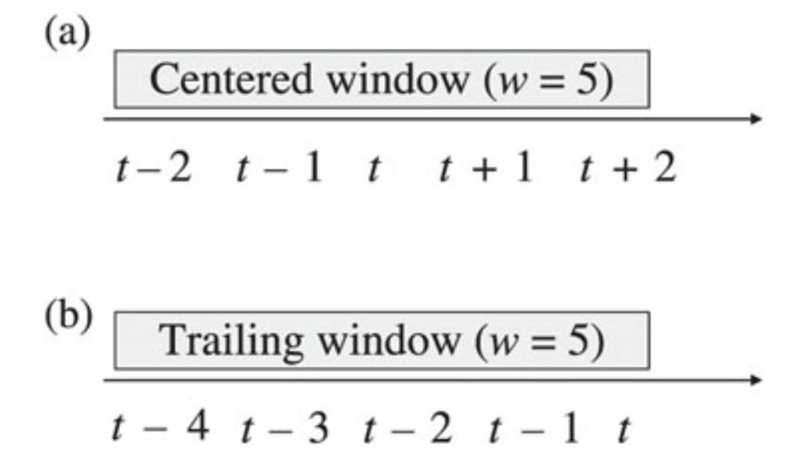
Smoothing Methods: Moving Average

Slide 15
Moving Average: Choosing Window Width
Like other methods such as k-nearest neighbors, w should be chosen based on the balance between under-smoothing and over-smoothing
Exploring different values of w to find the optimal one

Slide 16
Simple Smoothing: Exponential Smoothing
A popular forecasting method in business is exponential smoothing.
Its popularity derives from its flexibility, ease of automation, cheap computation, and good performance.
Simple exponential smoothing is similar to forecasting with a moving average, except that instead of taking a simple average over the w most recent values, we take a weighted average of all past values, such that the weights decrease exponentially into the past.
The idea is to give more weight to recent information, yet not to completely ignore older information.
where α is a constant between 0 and 1 called the smoothing parameter

Slide 17
Simple Smoothing: Exponential Smoothing
The smoothing parameter α, which is set by the user, determines the rate of learning.
A value close to 1 indicates fast learning (that is, only the most recent values have influence on forecasts)
whereas a value close to 0 indicates slow learning (past values have a large influence on forecasts).
Hence, the choice of α depends on the required amount of smoothing, and on how relevant the history is for generating forecasts.
Default values that have been shown to work well are around 0.1–0.2.
Some trial and error can also help in the choice of α
Based on prediction performance (RMSE)

Slide 18
Simple Smoothing: Shortcomings
Simple smoothing methods are useful only for series that lack trend and seasonality
Use regression model to de-trend and de-seasonalize & then use simple smoothing methods
Use more sophisticated smoothing methods

